Slide 1

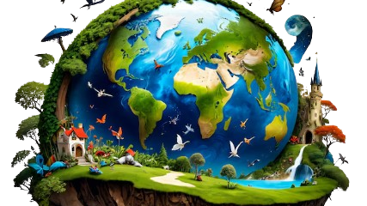
Climate Change-Reasons
Effects
Prevention
Made by Mohit Hajela SKS

Slide 2
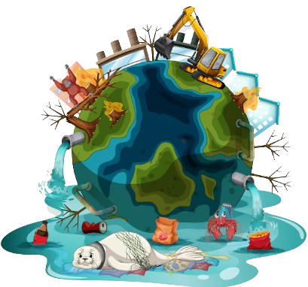
Climate Change-Reasons
Burning fossil fuels, cutting down forests and farming livestock are increasingly influencing the climate and the earth's temperature. This adds enormous amounts of greenhouse gases to those naturally occurring in the atmosphere, increasing the greenhouse effect and global warming.

Slide 3
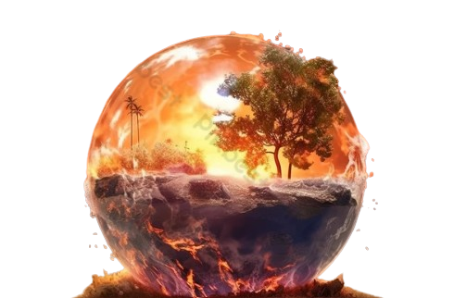
Effects of climate-change
Hotter temperatures
More severe storms
Increased drought
Climate change refers to long-term shifts in temperatures and weather patterns. These shifts may be natural, but since the 1800s, human activities have been the main driver of climate change, primarily due to the burning of fossil fuels (like coal, oil, and gas), which produces heat-trapping gases.

Slide 4
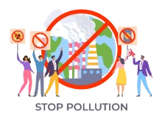

Prevention
Everyone can help limit climate change. From the way we travel, to the electricity we use and the food we eat, we can make a difference. Start with these 10 actions to help tackle the climate crisis.
Save energy at home
Walk, cycle, or take public transport
Eat more vegetables

